Slide 1
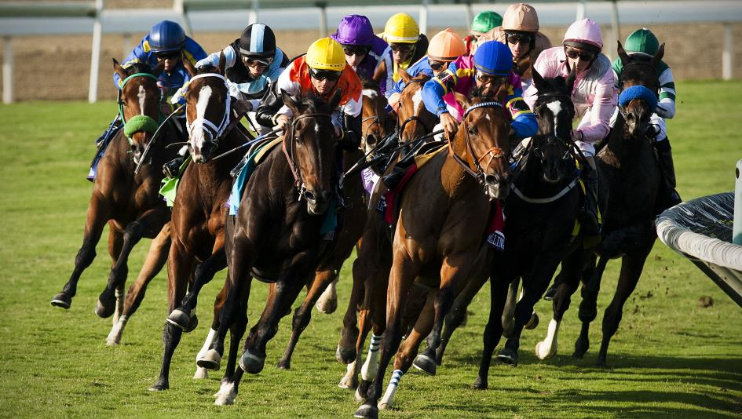
Off To the Races
Predicting A Winning Horse

Slide 2
The plan

Slide 3
Project Outline
Using Machine Learning predict horse race winners.
Back end design
Machine Learning
Front end design
Visualizations
Live Demo

Slide 4
Back End
ETL using Python to convert a CSV to SQL
PostGreSQL
Flask API and web server

Slide 5
Machine Learning
We tried several models using different predictors.
We settled with Linear Regression on predicting the time a winner would finish the race.
Random Forest Classifier
Logistic Regression
SMOTE (Synthetic Minority Oversampling Technique)
Linear Regression

Slide 6
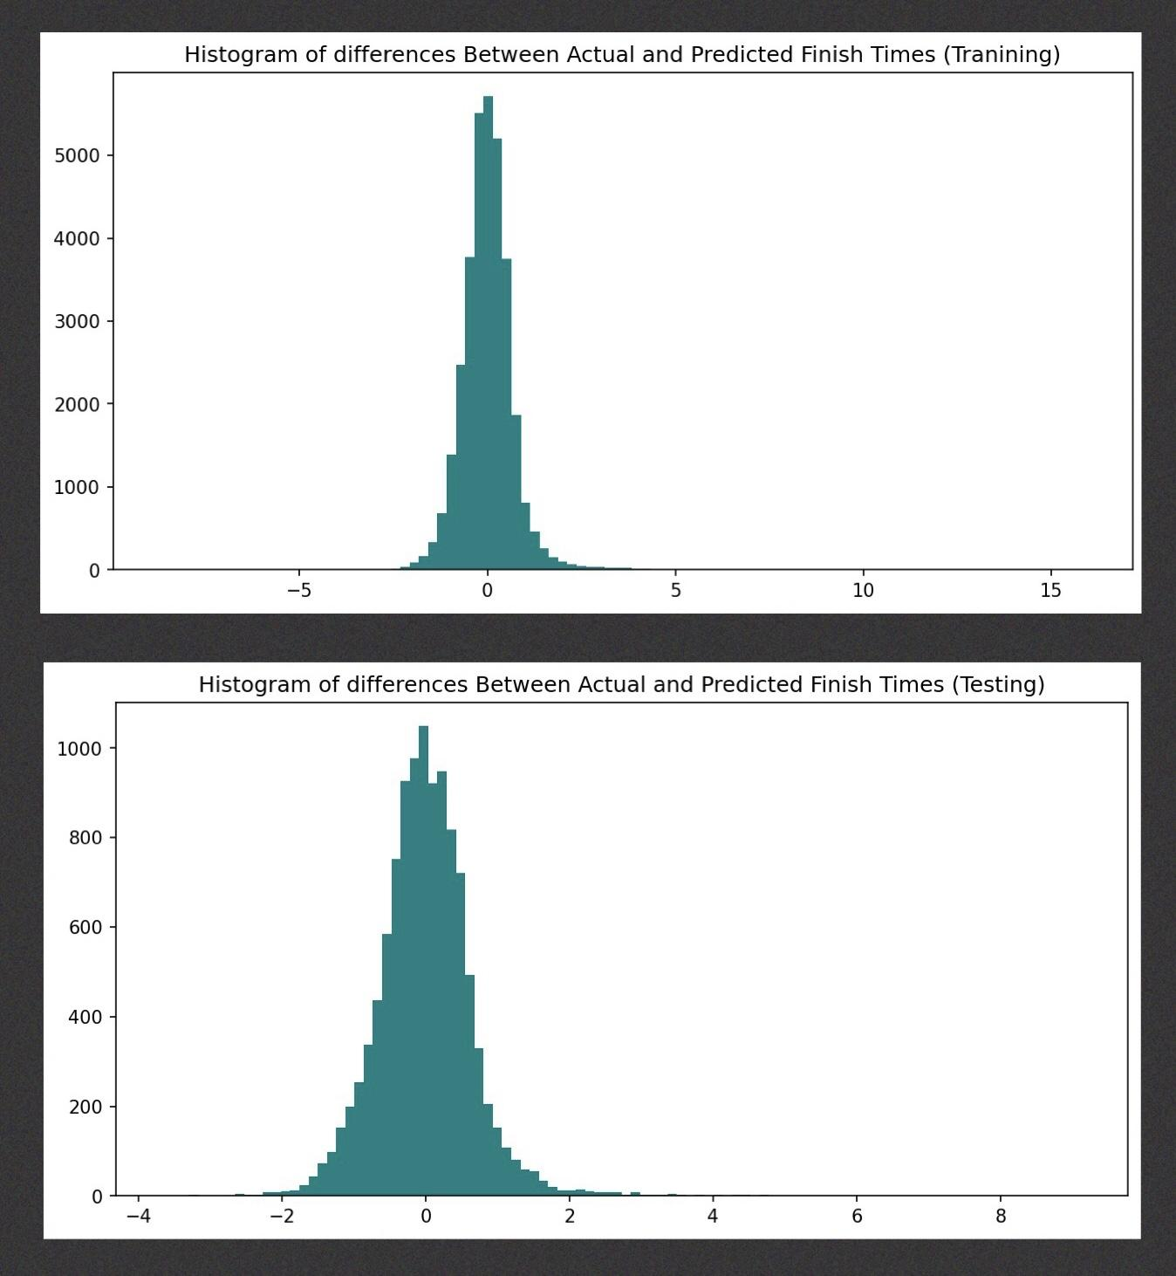
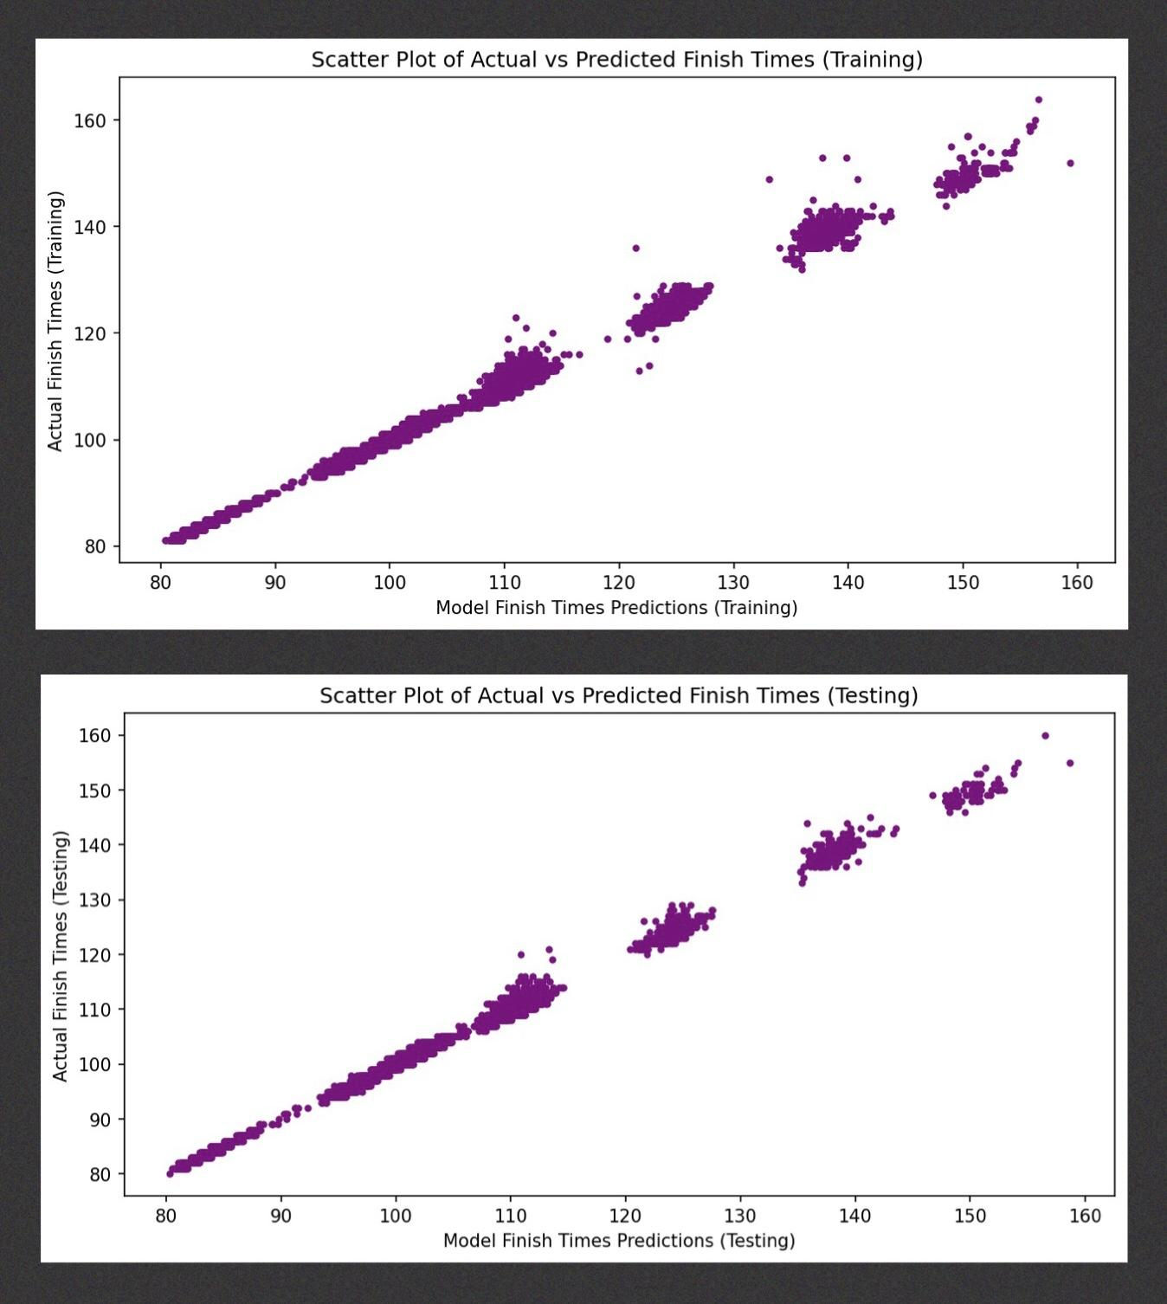
Evaluating our Model
In both sets of comparisons, we see that the dataset is fairly normalized (histogram) and the actual vs. predicted times follow a regressed diagonal line (scatter plot).
To check for overfitting, we plotted actual finish times to the finish times our model predicted for both the training and testing data.

Slide 7
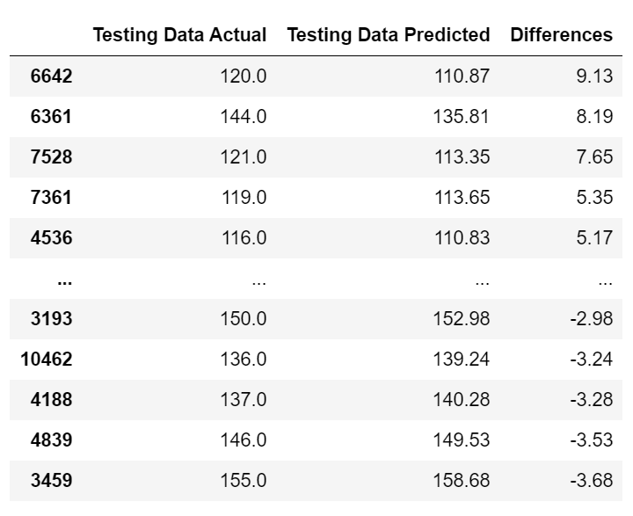
Model Analysis Continued
Our Model handled the test data well. The largest variance between actual and predicted was 9.13 seconds
A limitation for our end program is that our model takes in 23 features.
We utilized coefficients to identify 5 of the most influential features. These were the features we allow our end user to modify.

Slide 8
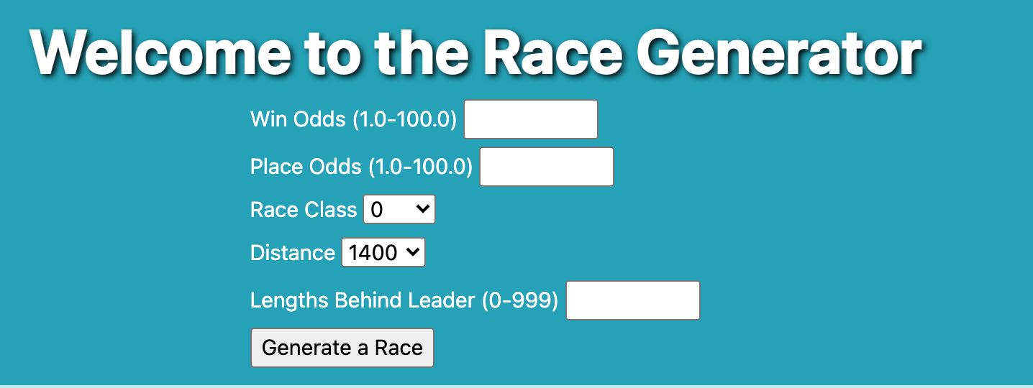
Front End
3 Endpoints:
Home
Visualizations page
Displays Tableau visualizations
Race results page
Displays results from Mock race
Notes:
Tammi

Slide 9

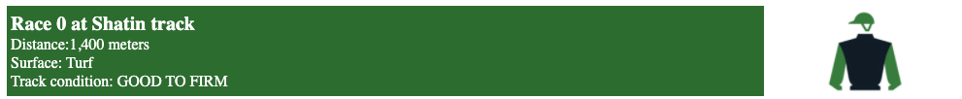
Visualizations
Created two dashboards using Tableau
Data connection: CSV files
Off to the races Dashboard
Race Track Dashboard
Notes:
Tammi

Slide 10

Heroku Deployment
Maintaining Good Structure
Created the Connection to Deploy via Heroku
Removed/Installed Modules
Base Heroku Postgres Vs Basic Heroku Postgres

Slide 11
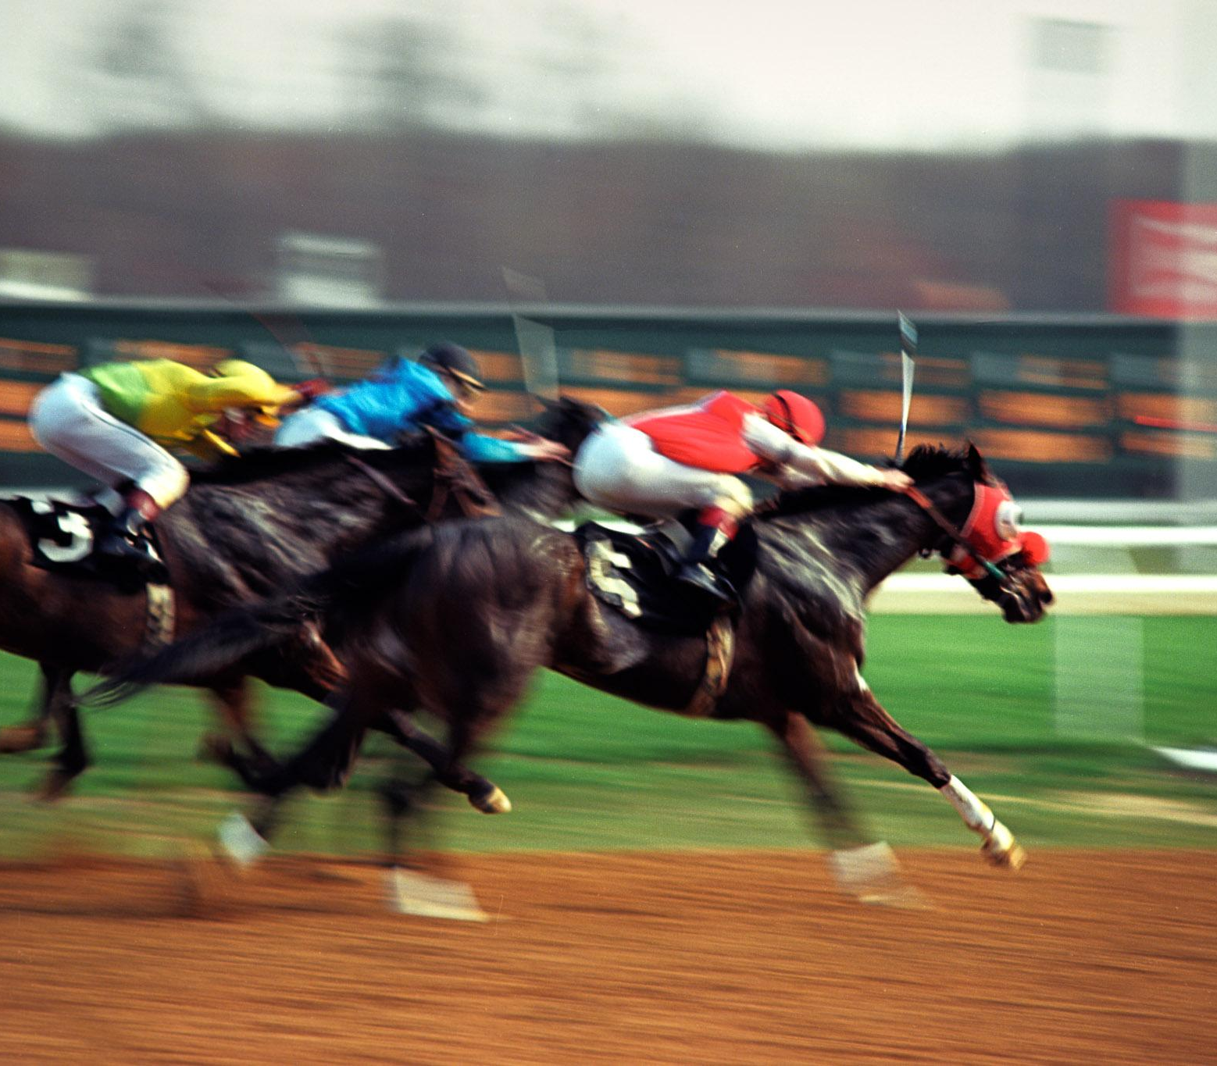
Demo time!

